Slide 1


Slide 2
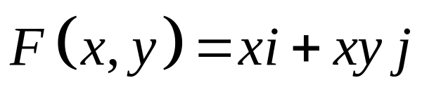
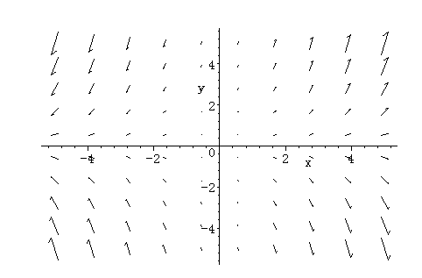
Vector functions
F(x,y)=P(x,y)i+Q(x,y)j
Example

Slide 3
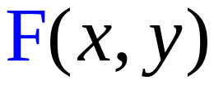
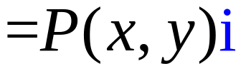
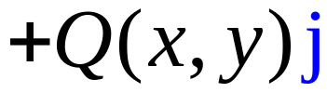
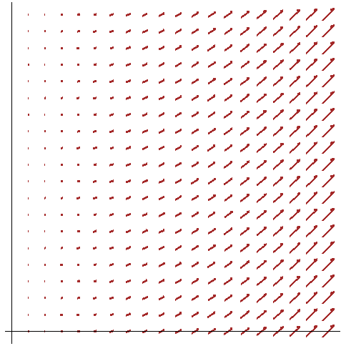
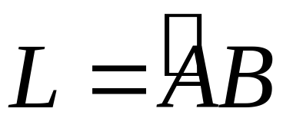


Starter
Work done a non-constant force in the plane
Vector function
path
A force acts on a particle, moves it from point A to point B, find the work done
with(plots):
f:=fieldplot([x,x*x],x=0..1,y=0..1,color=brown,thickness=3):
x_axis:=implicitplot(y=0,x=0..1,y=0..1,thickness=1,color=black):
y_axis:=implicitplot(x=0,x=0..1,y=0..1,thickness=1,color=black):
display(f,x_axis,y_axis,tickmarks=[0,0],scaling=constrained);

Slide 4


Slide 5


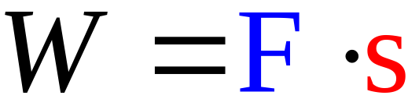
Recall
F is a constant

Slide 6
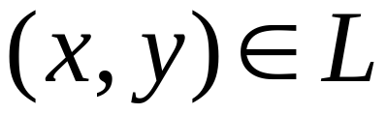
Now, along the curve：
At the point
The force

Slide 7




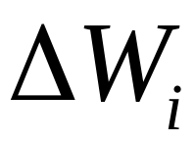
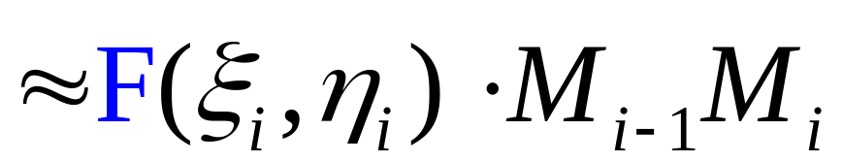
(1) partition
(2) approximation
approximation

Slide 8
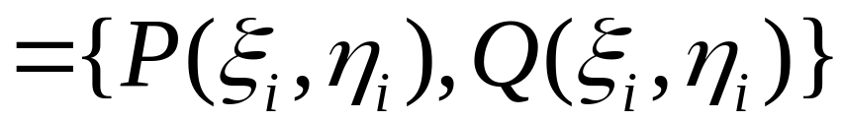
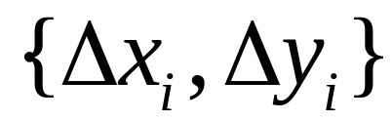
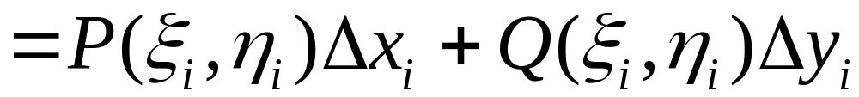

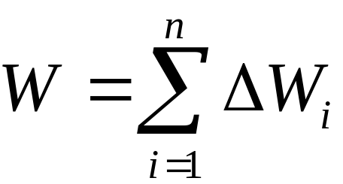

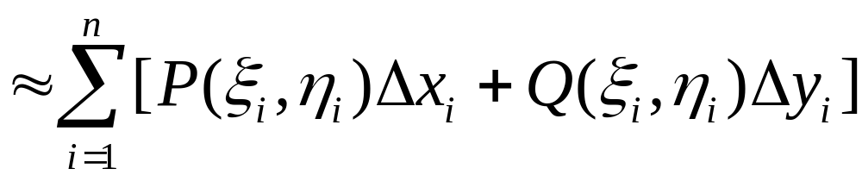
(3) summation

Slide 9
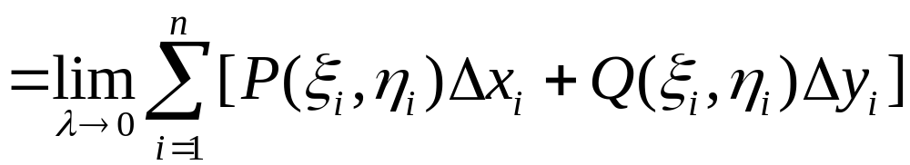

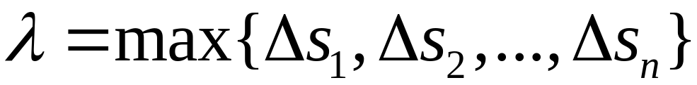
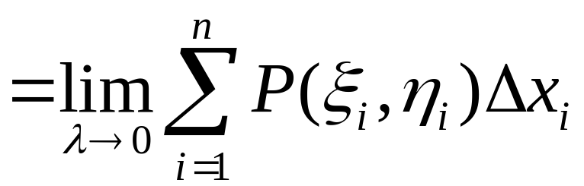
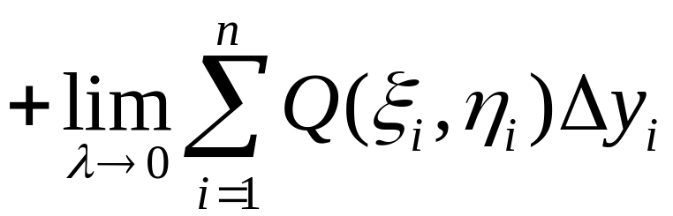
(4) Take the limit

Slide 10
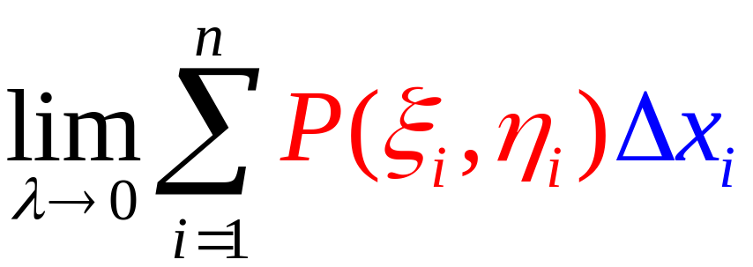
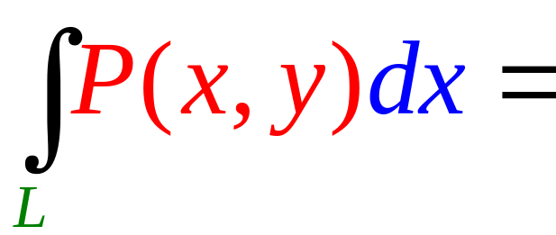
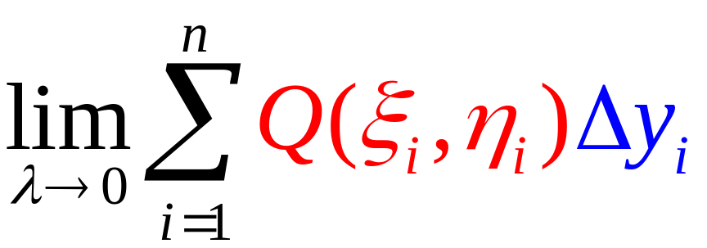
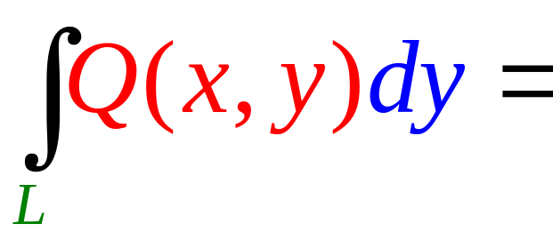
Line integral with respect coordinates
Line integrals with respect to x
Line integrals with respect to y

Slide 11
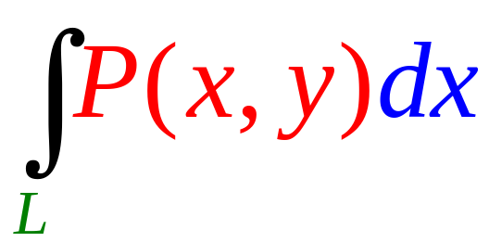
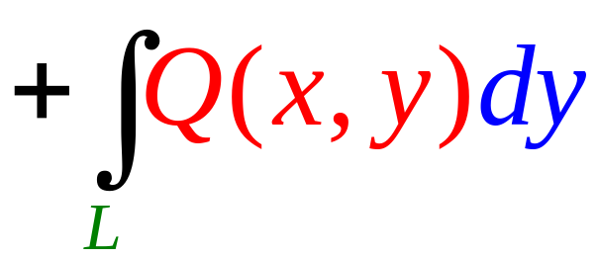
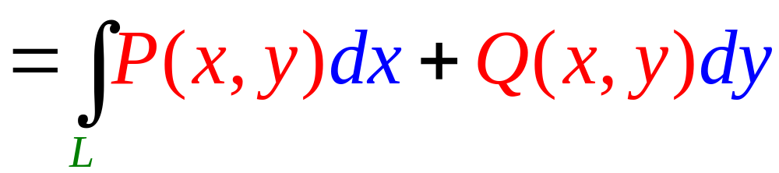
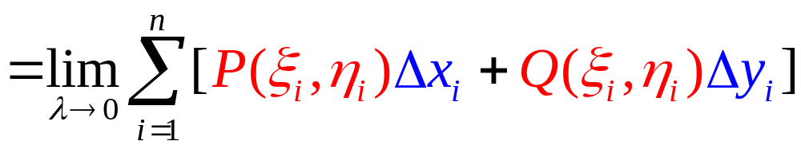
Note

Slide 12
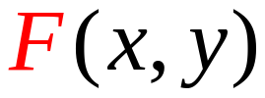
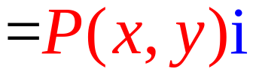
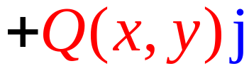

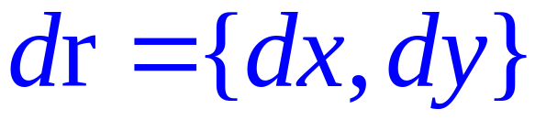
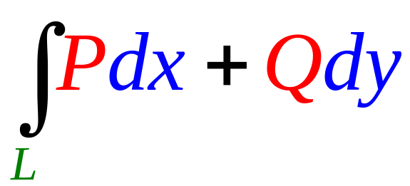
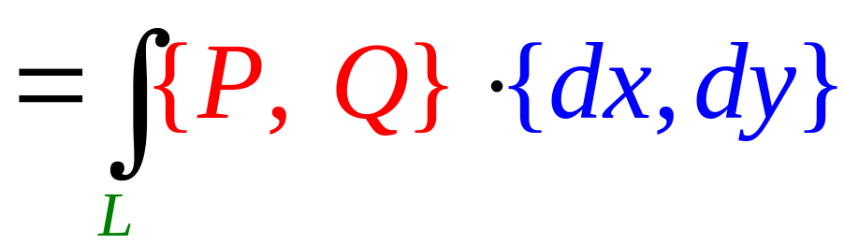


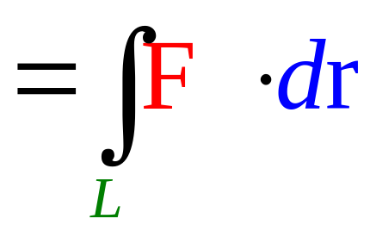
Vector form
Tangent vector

Slide 13
Line integral over vector field

Slide 14
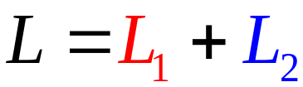
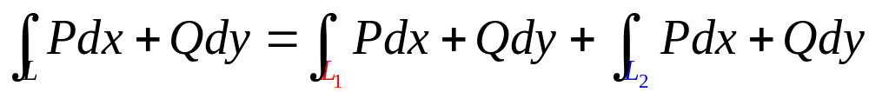


Properties

Slide 15


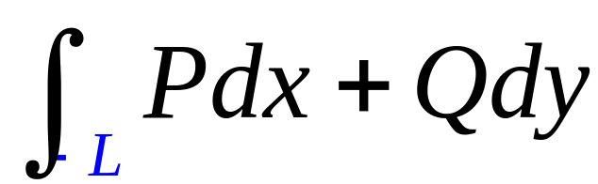
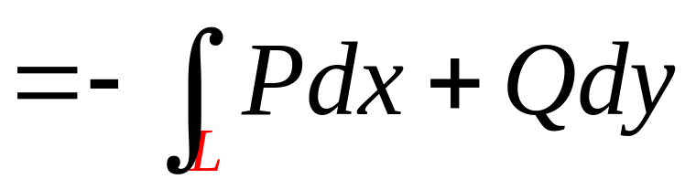
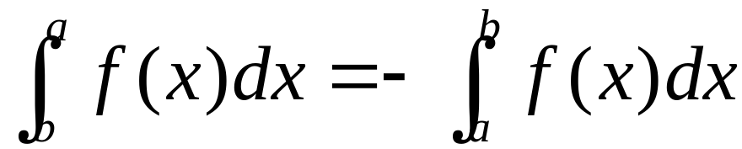
L is directed curve
Similar to：

Slide 16
How to compute?

Slide 17
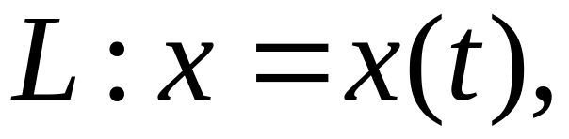
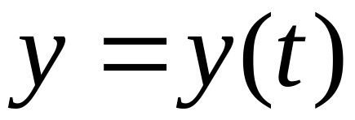
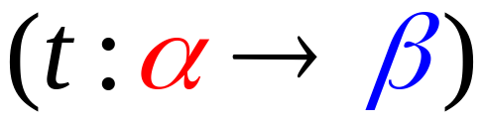
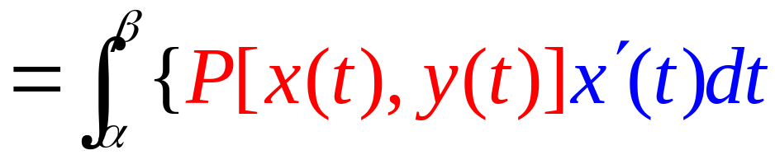
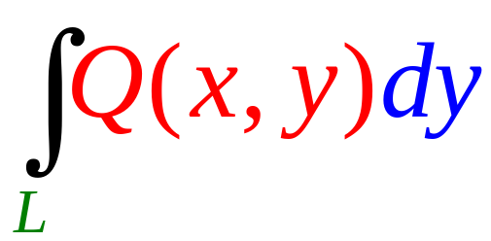
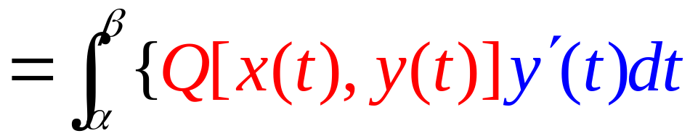
(1) L parametric form：
initial
terminal
then

Slide 18
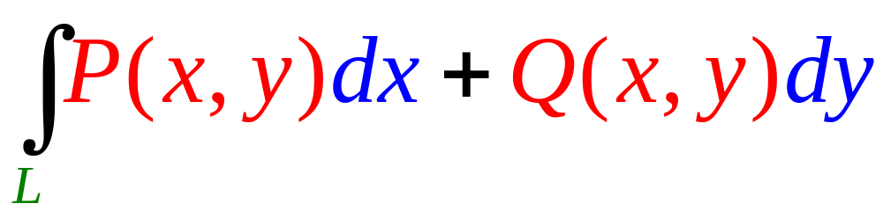
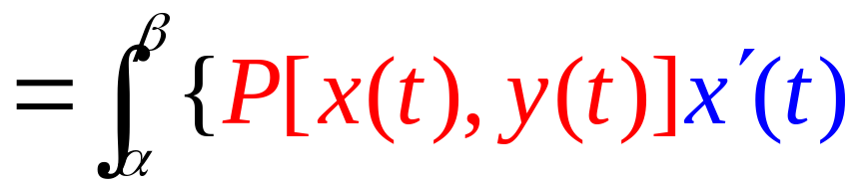
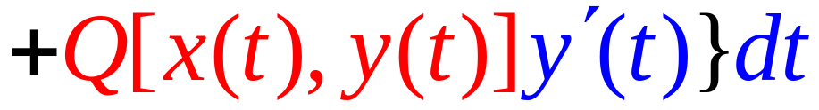

Slide 19

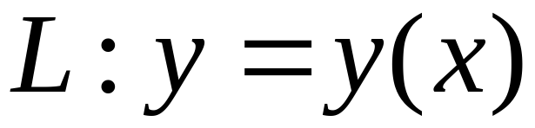





(2) If L ：is give by an explicit formula
then

Slide 20



Slide 21









Example
Solution
Method 1
L rectangular form：
hard

Slide 22










Method 2
L parametric equations
easier

Slide 23






Example
Solution
(1)

Slide 24






(2)
Path dependent

Slide 25










Example
L: bounded by
Direction: see the diagram
Solution

Slide 26






Slide 27









(4) In the space
then

Slide 28










Example
Solution

Slide 29














例. 设在力场
作用下, 质点由
沿Γ 移动到
其中 Γ 为
试求力场对质点所作的功.
解: (1)
(2) Γ 的参数方程为

Slide 30











其中
从 z 轴正向看为顺时针方向.
解: 取 Γ 的参数方程

Slide 31
END

